Slide 1
Lecture 4
Divide and Conquer

Slide 2
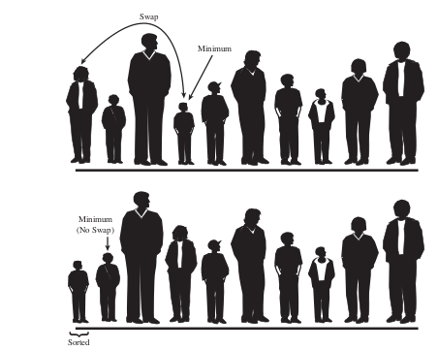
Selection sort
Idea:
Find the smallest element in the array
Exchange it with the element in the first position
Find the second smallest element and exchange it with the element in the second position
Continue until the array is sorted

Slide 3
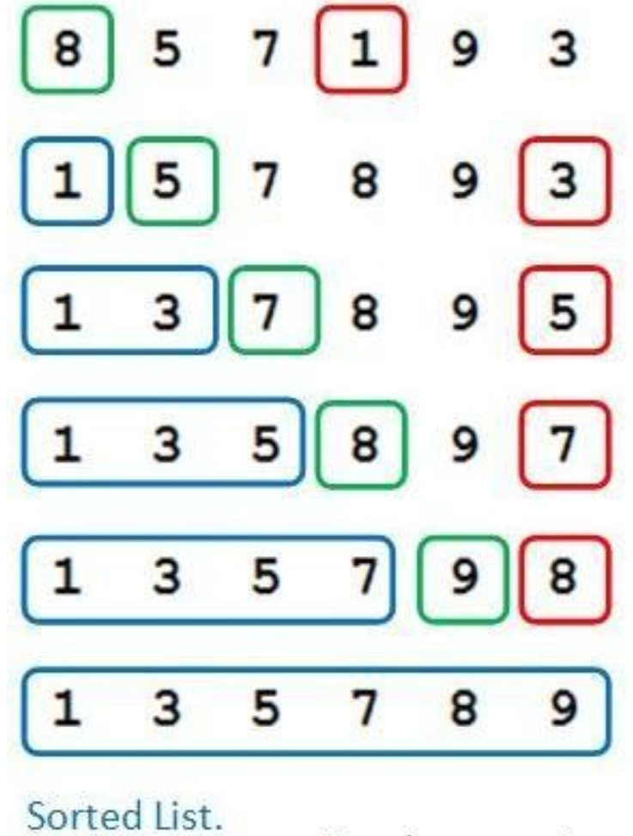
Algorithm
SELECTION-SORT(A)
n ← length[A]
for j ← 1 to n - 1
do smallest ← j
for i ← j + 1 to n
do if A[i] < A[smallest]
then smallest ← i
exchange A[j] ↔ A[smallest]

Slide 4
Analysis of Selection sort
Selection Sort(A) | Cost | Times
n ← length[A] for j ← 1 to n - 1 do smallest ← j for i ← j + 1 to n do if A[i] < A[smallest] then smallest ← i exchange A[j] ↔ A[smallest] | C1 C2 C3 C4 C5 C6 C7 | 1 n (n-1) (n-1)

Slide 5
Program

Slide 6
Strassen’s matrix multiplication
The problem:
Multiply two matrices A and B, each of size

Slide 7
The conventional method
c₀₀ c₀₁ a₀₀ a₀₁ b₀₀ b₀₁
= *
c₁₀ c₁₁ a₁₀ a₁₁ b₁₀ b₁₁
a₀₀ * b₀₀ + a₀₁ * b₁₀ a₀₀ * b₀₁ + a₀₁ * b₁₁
=
a₁₀ * b₀₀ + a₁₁ * b₁₀ a₁₀ * b₀₁ + a₁₁ * b₁₁
3 for loops
Time complexity =O(N³)

Slide 8
The divide and conquer approach
A,B and C are square matrices of size
a, b, c, d are sub-matrices of A, of size
e, f, g, h are sub-matrices of B, of size
ae+bg af+bh a b e f
= *
ce+dg cf+dh c d g h
8 multiplications
C
A
B
4 additions
T(N) = 8T(N/2) + O(N²) = O(N³)

Slide 9
Strassen’s Matrix Multiplication
c₀₀ c₀₁ a₀₀ a₀₁ b₀₀ b₀₁
= *
c₁₀ c₁₁ a₁₀ a₁₁ b₁₀ b₁₁
m₁+ m₄- m₅ + m₇ m₃ + m₅
=
m₂ + m₄ m₁+ m₃ - m₂ + m₆
m₁ = (a₀₀ + a₁₁) * (b₀₀ + b₁₁)
m₂ = (a₁₀ + a₁₁) * b₀₀
m₃ = a₀₀ * (b₀₁ - b₁₁)
m₄ = a₁₁ * (b₁₀ - b₀₀)
m₅ = (a₀₀ + a₀₁) * b₁₁
m₆ = (a₁₀ - a₀₀) * (b₀₀ + b₀₁)
m₇ = (a₀₁ - a₁₁) * (b₁₀ + b₁₁)
7 multiplications
6 additions
4 subtractions

Slide 10
Analysis of Strassen’s method
T(n) = 7^{log 2n} = n^{log 27} ≈ n^{2.807}
T(n) = n^{2.807} < n³
Strassen’s matrix multiplication has better asymptotic efficiency but is not used
in practice.
T(n) = 7T(n/2) + O(n²) = O(n³)

Slide 11
Reasons
The constants used in Strassen’s method are high and for a typical application conventional method works better.
The submatrices in recursion take extra space.
Because of the limited precision of computer arithmetic on noninteger values, larger errors accumulate in Strassen’s algorithm than in conventional method

Slide 12
Program

